Slide 1
Microcomputer Principles and Applications
08/01/2020
Final Project Report
林修維 – B10702113
羅偉明 – B10702109
Project Title : Building Pudding Protector using ARM Cortex and C language .

Slide 2
TABLE OF CONTENTS
01
02
03
04
Introduction
Prototype Requirements
Design and Write program
Discussion

Slide 3
Introduction
@ If you work in an office or live in a home with people who have a sweet tooth and sticky fingers, this is the dessert-saving device you need .
@ The primary components of the Pudding Protector system are a sensor-equipped plate, a monitor and a ultrasonic sensor. When Pudding Protector detects that your precious pudding is being pinched, the ordinarily docile face shows visible anger and repeatedly shouts “The pudding has be stolen!” , “Return the pudding!” through its speakers, alerting anyone in earshot to the crime in progress .

Slide 4
@ If the thief repents and puts the pudding back, Pudding Protector calms down and announces “The pudding has returned” but this might have the deviously minded thinking they can beat the system. Just take the pudding and put any object in its place, and you’ve pulled off the perfect crime, right? Nope, because Pudding Alert knows how much the pudding that was initially in place weighs, and if it detects a different weight on the plate instead, it knows you’re trying to substitute it with something less valuable than pudding and shouts “This isn’t pudding!” .
@ Pudding Protector works by sensing a change in the weight on the pressure plate, it could also easily function as Beer , Drinks , Chocolate , Snacks , …. Protector .

Slide 5
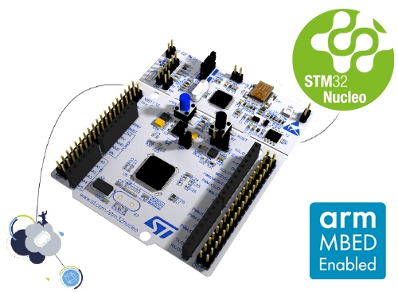
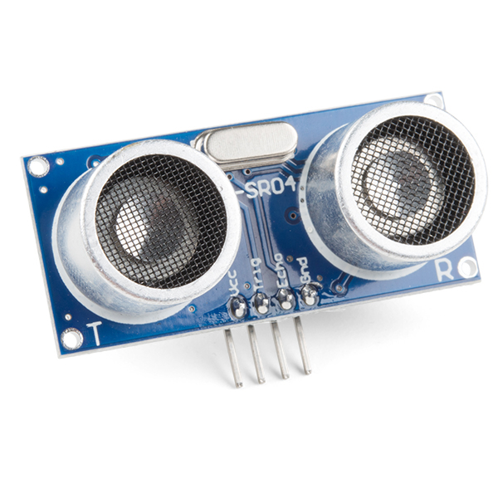
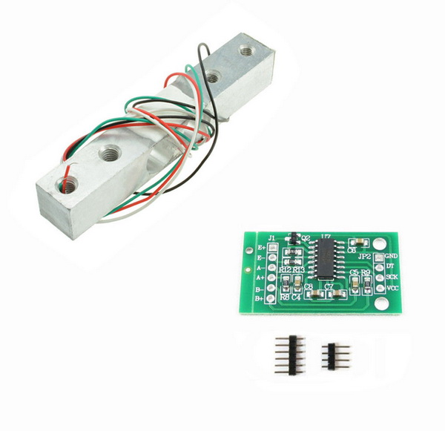
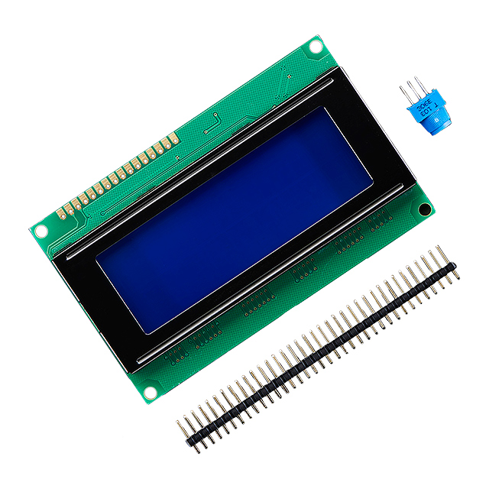
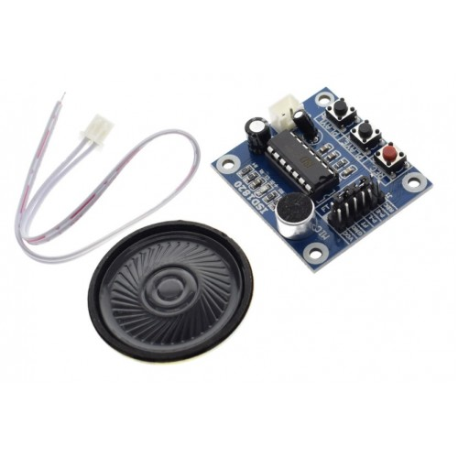
Prototype Requirements
@ Hardware :
1 . STM32L053R8 (ARM Cortex-M0)
3 . HCSR04 (Ultrasonic Sensor)
4 . Loadcell 5kg + ADC HX711
2 . LCD 20x4
4 . ISD1820 (Speaker module)
Breadboards , Resistors , Wires , White Glue , Carton paper , Paper knife , Tape , …

Slide 6

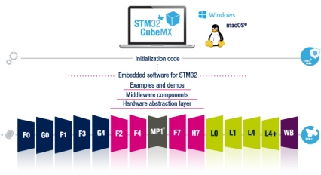
@ Software
1 . Keil uVision 5
2 . STM32CubeMX

Slide 7
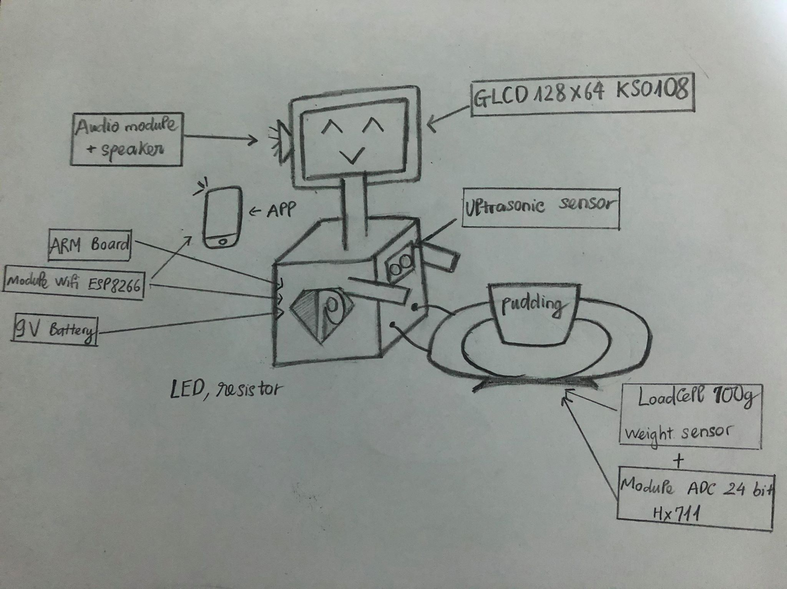
Design and Write program
@ Outline

Slide 8
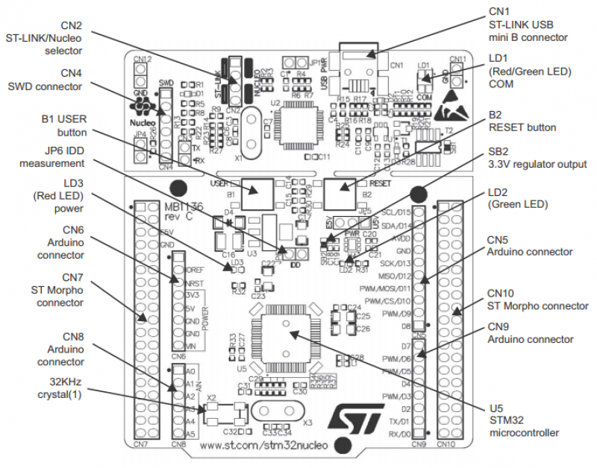
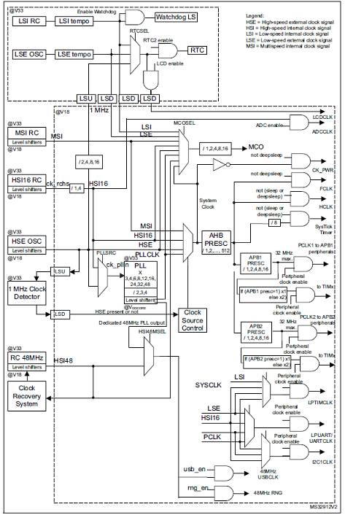
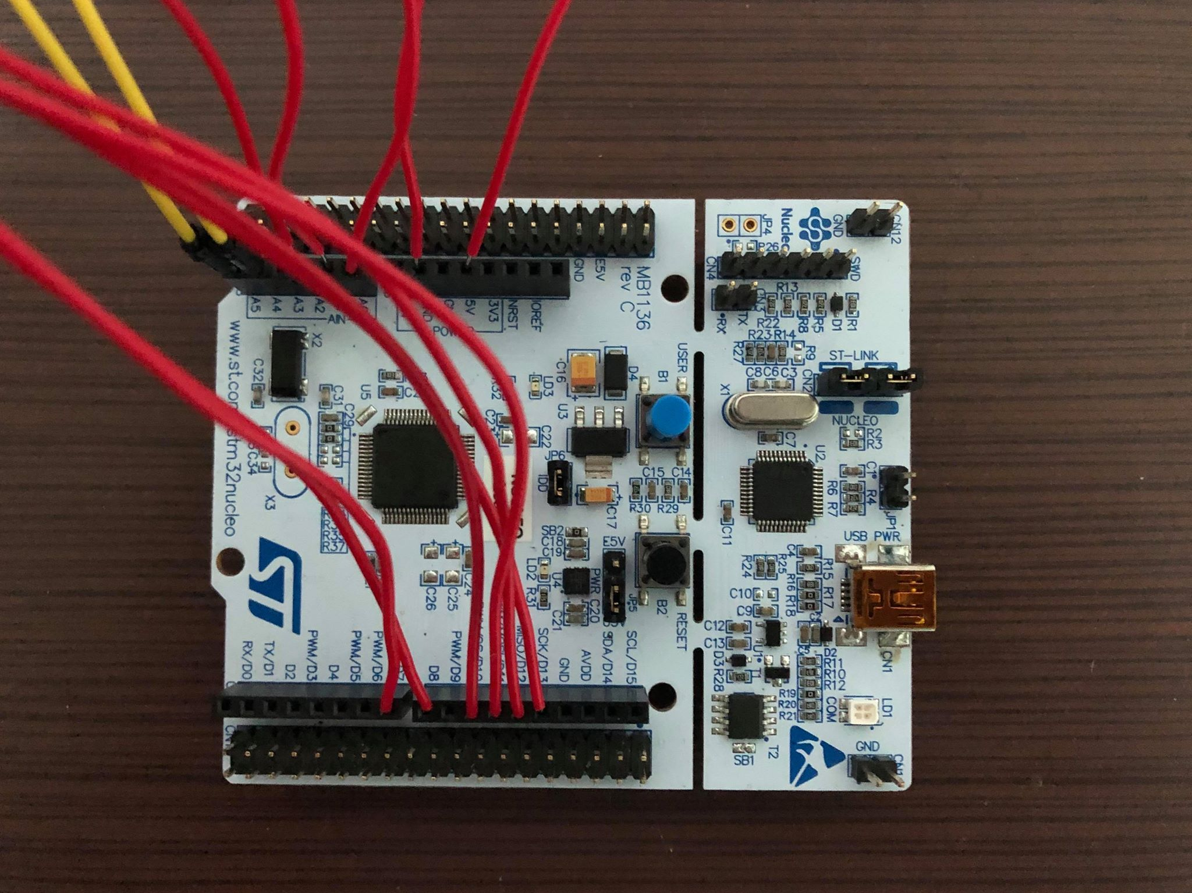
@ Schematic
Ultrasonic Sensor
Monitor
ARM Module
Weight Sensor
ADC HX711
Speaker Module
@ STM32L053R8

Slide 9
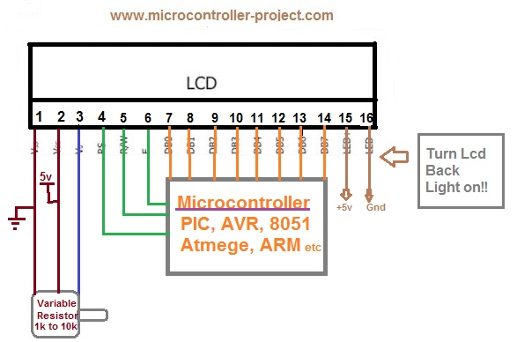
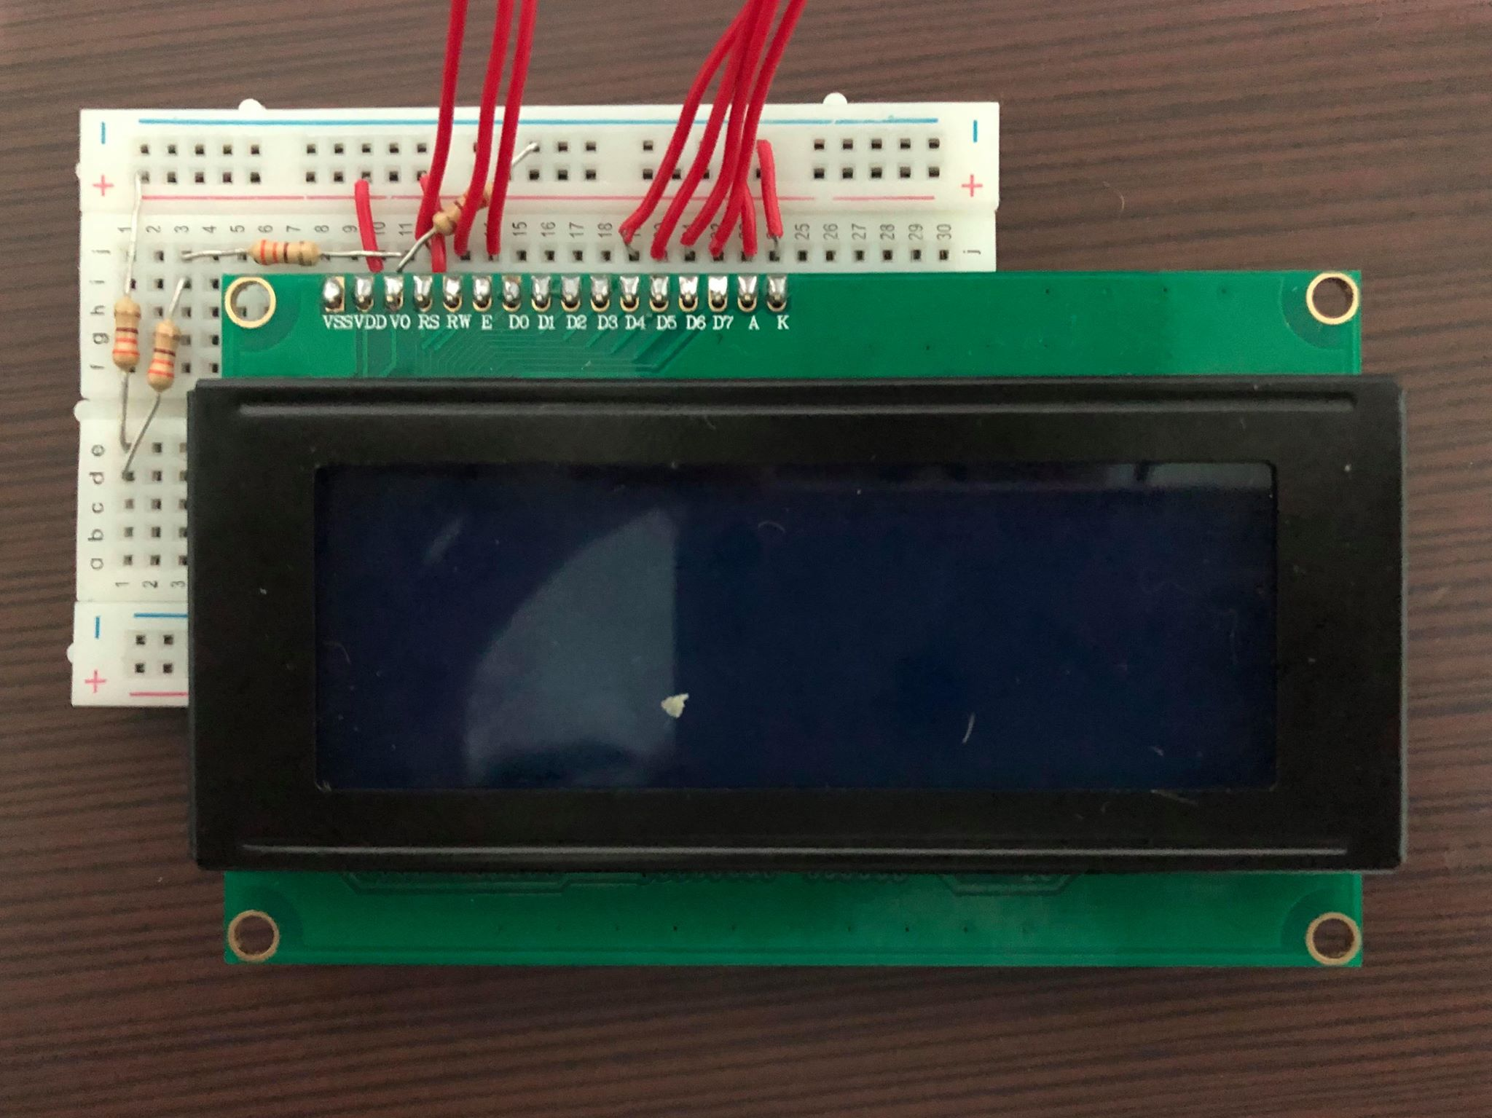
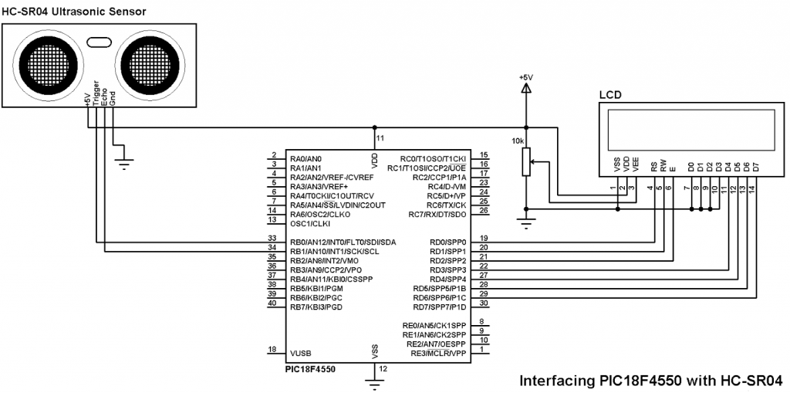
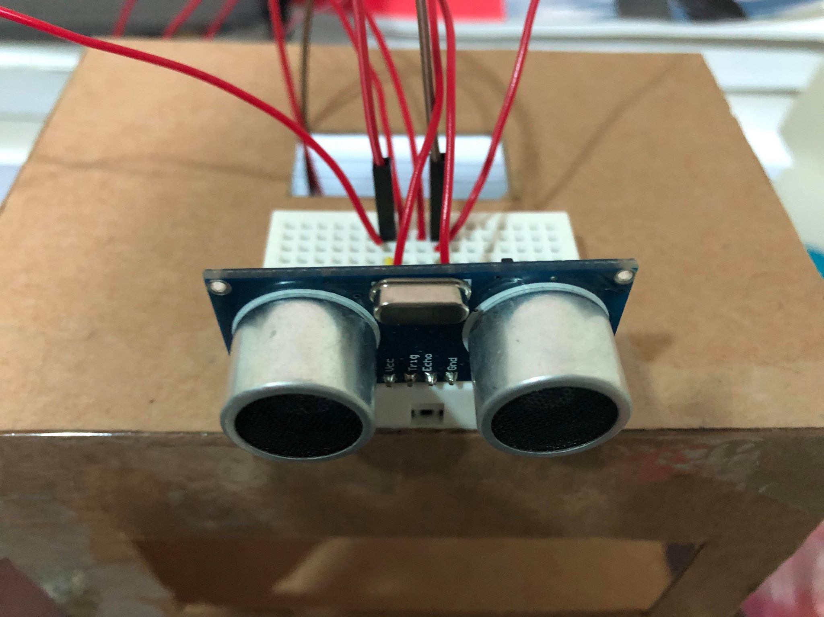
@ Monitor
@ Ultrasonic Sensor

Slide 10
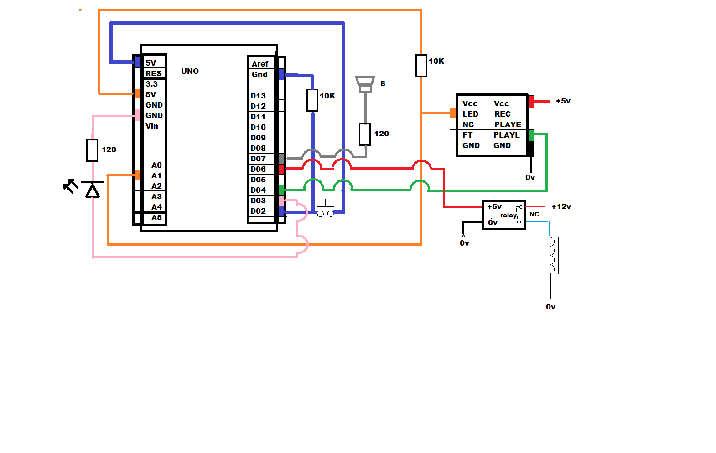
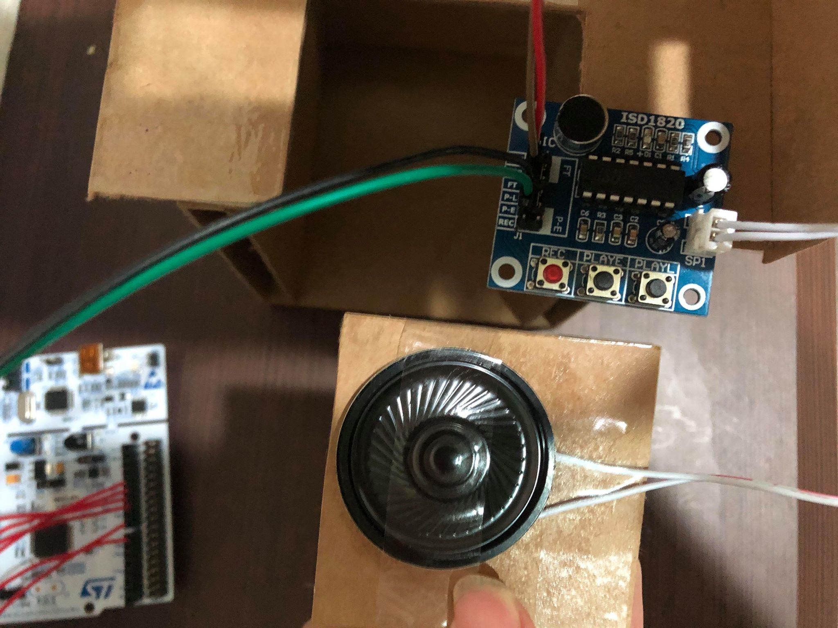
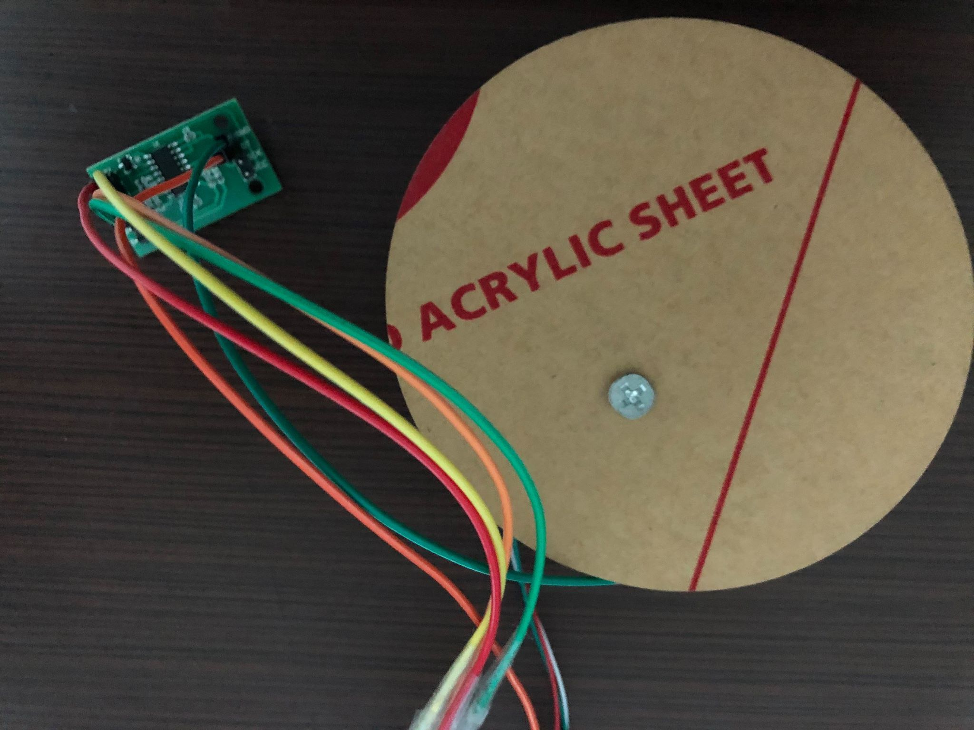
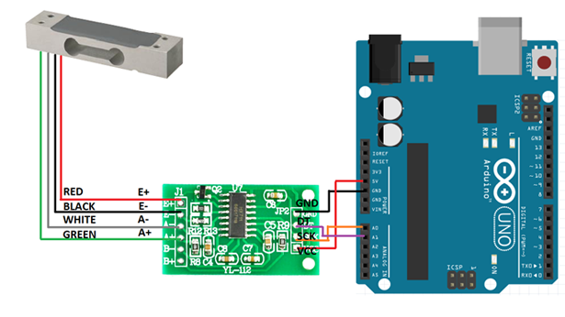
@ Speaker module
@ Weight Sensor

Slide 11
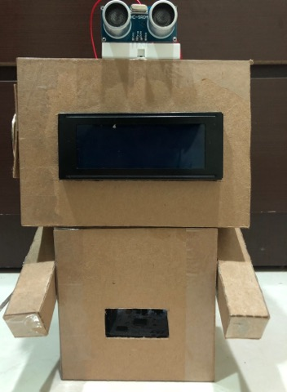
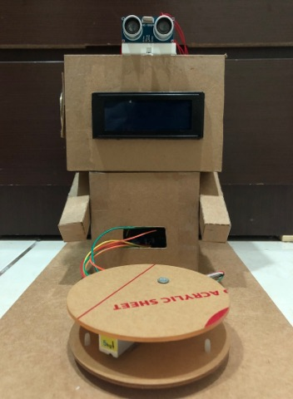
@ Exterior Design
@ Overall

Slide 12
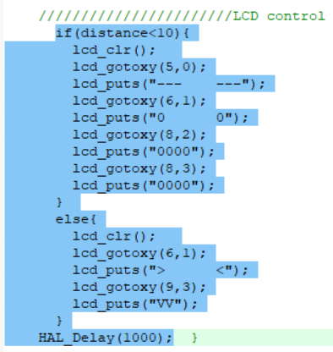
@ Programming (test code)
1 . Monitor

Slide 13
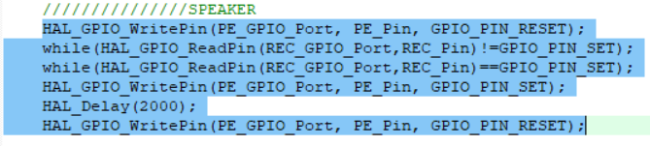
2 . Speaker

Slide 14
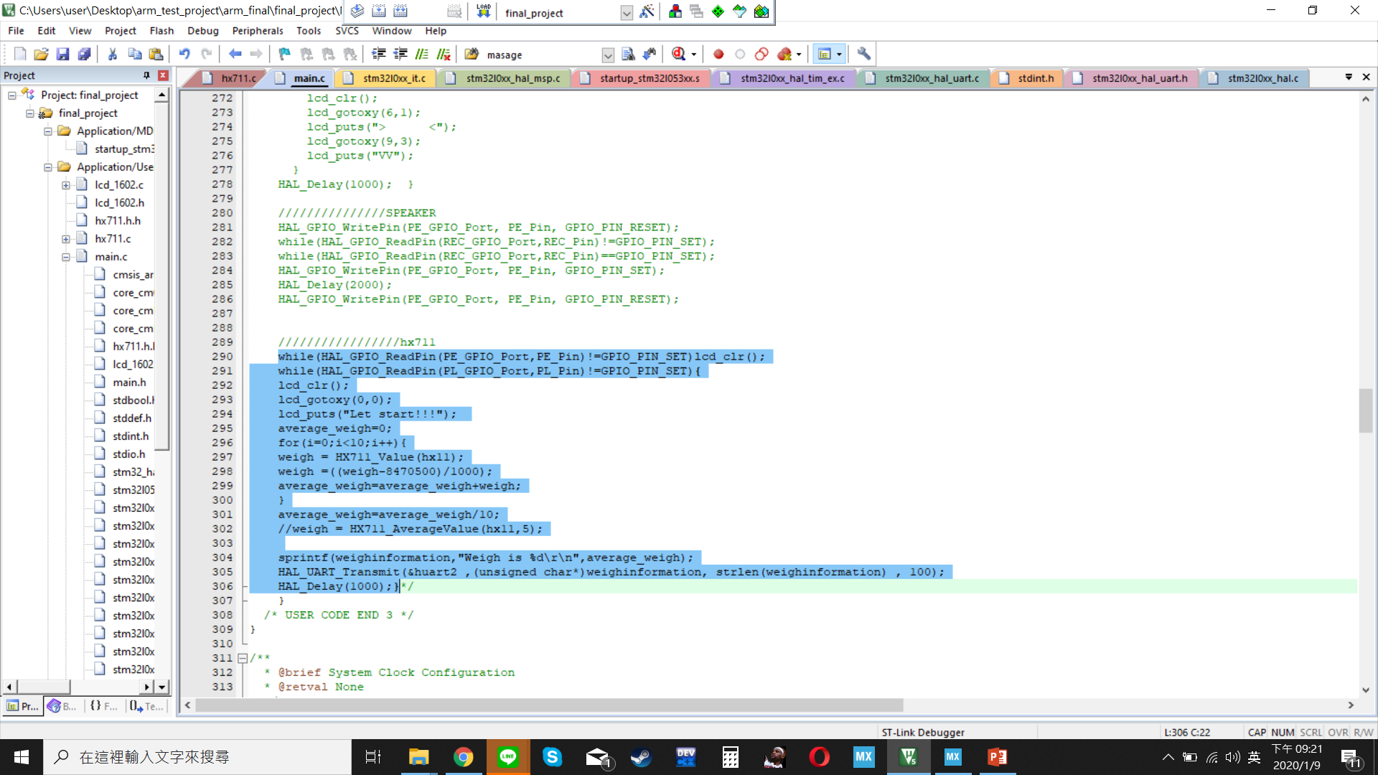
3 . Weight Sensor

Slide 15
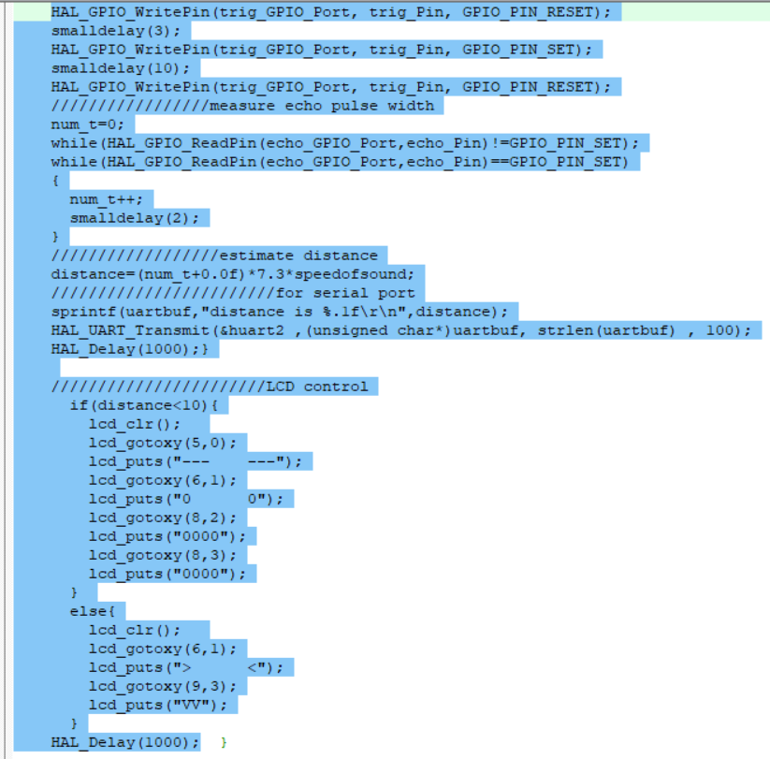
4 . Ultrasonic Sensor

Slide 16
Discussion
@ Conclusion
Problem
Solution
焊接
超音波的控制
元件損毀
沒有按鈕
元件和線太多
謝謝班上同學熱心援助
接收訊號跟輸出訊號中間的時間
無法避免，除非你不騎機車； 元件不要買對岸的
就地取材
做專題前要先預知會有這種狀況

Slide 17
@ Assignment
Write program for ARM ,
Ultrasonic sensor ,
Weight sensor ,
LCD and Speaker ,
Circuit Testing .
Creative development ,
Circuit design ,
Exterior Design ,
Find related document ,
Write Report .
修修維維
偉明

Slide 18
@ Process ( 4 weeks)
W
Prepare required software and hardware . Ultrasonic sensor controlling .
1
W
Weight sensor and LCD controlling .
2
Audio module controlling and Programming finish .
W
3
Exterior design , Installation finish and Demo .
W
4
@ Budget ( Exclude ARM board )
Cost $1200

Slide 19
Future Development
In the future, I hope that it can be applied to unmanned stores or grocery store. In addition to achieving the effect of supervision, it can also affect people's hearts through the lovely interaction of computers.

Slide 20
@ Reference
https://community.st.com/s/
https://www.st.com/content/st_com/en/support/support-home.html
http://www.datasheetcatalog.com/
https://forum.arduino.cc/
https://www.arm.com/support
https://circuitdigest.com/
https://github.com/

Slide 21
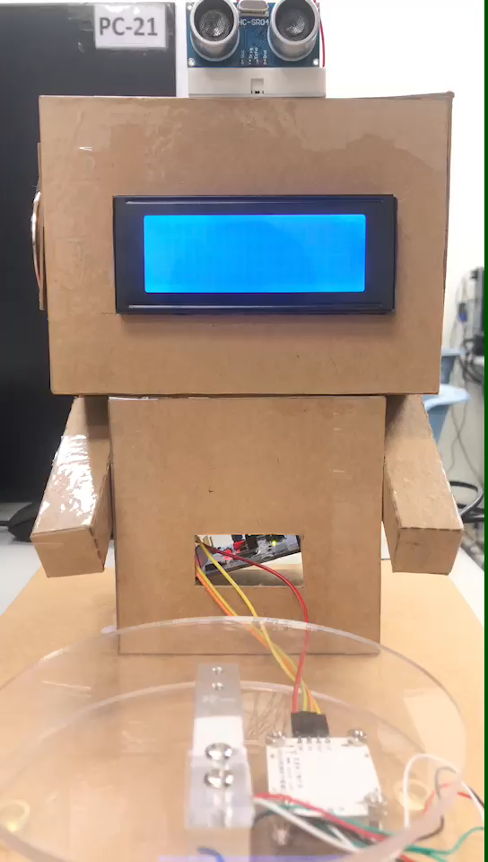
DEMOoooooooo

Slide 22
Thanks for watching !

